Slide 1



Using workflowr for reproducible research
RLadies 13/10/2022 Jovana Maksimovic, PhD
https://github.com/JovMaksimovic @JovMaksimovic

Slide 2
Presentation outline
About me
My scientific programming journey (in broader context)
How I used to do things (aka the dark ages)
How things improved (aka when I saw the light)
Paradigm shift
What is workflowr and why do I love it?
workflowr usage example (with live demo!)
Extra tips for enhancing reproducibility
Summary

Slide 3



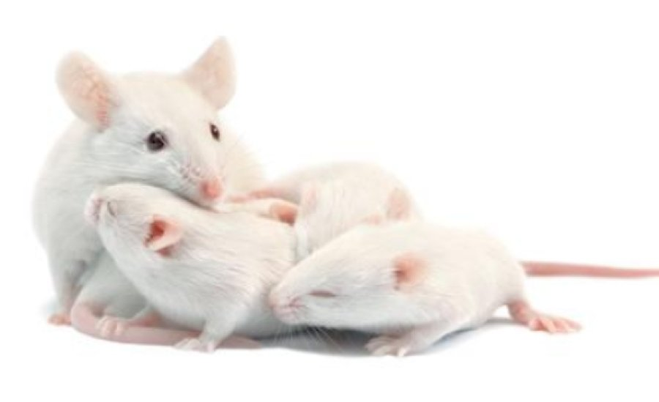
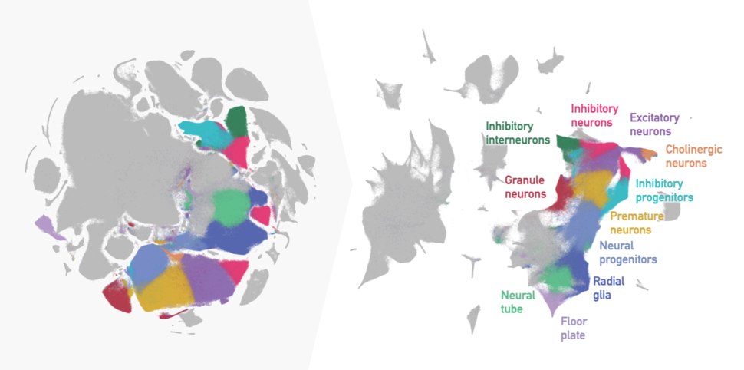
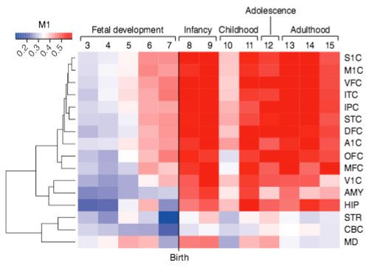
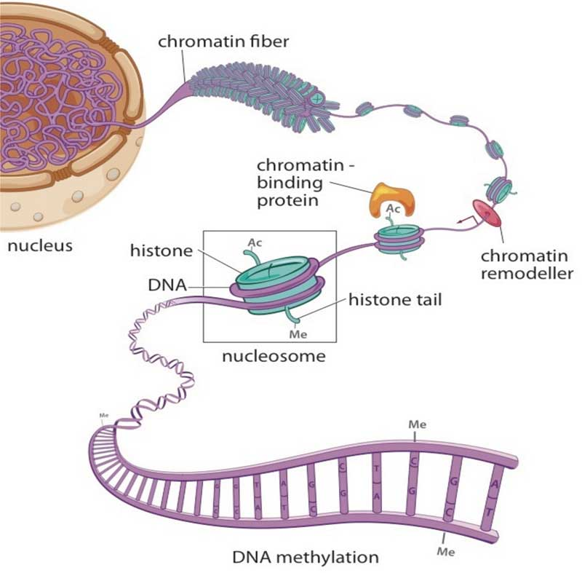


I mostly work on human development & disease…
I am a computational biologist at Peter Mac
…sometimes using data from mice or other models
I now primarily work on single-cell RNAseq data…
Bulk RNAseq
Microarrays
ChIPseq
ATACseq
BSseq
Microarrays
…and a lot of gene expression data
I am co-author of an R Bioconductor package for methylation array analysis
I have analysed a lot of epigenetic data…
Notes:
This is me.
I am a post doc at the Murdoch Childrens Resarch Institute at the Royal Children’s Hospital in Melbourne.
Somewhat unsurprisingly, I work mostly with human data focusing on disease and development, but sometimes I work on data from mice and other model organisms.
So, a lot of what I will talk to today will be about humans, but many of the principles relate to other species as well.
In my day to day work, I mostly analyse epigenetic data from a variety of sequencing and array platforms.
I also analyse a lot of gene expression data from RNAseq and microarrays.
And, when I’m not analysing data, I occasionally develop methods and write software. Along with my colleague Belinda Phipson, I have developed a software package for analysing methylation array data called missMethyl, which is freely available online from the Bioconductor website, which I’ll tell you a little more about later.

Slide 4







My scientific programming journey
bash, C++, Java, Fortran, SQL, S, R
bash, Perl, Python, C++
bash, R, Visual Basic, SQL
R, bash, Python, Groovy, Java
Research Assistant
Bioinformatics
Research Assistant
Bioinformatics
BBinf BSc
Genetics
Biochemistry Computer Sci
Methylation array analysis workflow paper published
Graduate Program
Bioinformatics
PhD
Computational Biology
Post Doc
Bioinformatics
Post Doc
Bioinformatics
missMethyl in Bioconductor
2002
2003
2004
2005
2006
2007
2008
2009
2010
2011
2012
2013
2014
2015
2016
2017
2018
2019
2020
2021
2022
Sweave
Git
GitHub Bitbucket
workflowr
knitr
rmarkdown
R CRAN 1997 Bioconductor 2001
Hadley Wickham Tidy data paper

Slide 5
How I used to do things (aka the dark ages)
Learnt R and data analysis largely on my own
Trying to reproduce analyses from papers was virtually impossible
Full code was rarely shared
Methods descriptions were inadequate and vague
Online tutorials were not as widely available
More general programming stuff
Not many specific examples of bioinformatic analyses
Some Bioconductor vignettes were very good e.g. limma, Affy
I wasn’t aware of Sweave so writing my thesis was a painful exercise involving Microsoft Word, Excel and copy and paste

Slide 6
My scientific programming journey
bash, C++, Java, Fortran, SQL, S, R
bash, Perl, Python, C++
bash, R, Visual Basic, SQL
R, bash, Python, Groovy, Java
Research Assistant
Bioinformatics
Research Assistant
Bioinformatics
BBinf BSc
Genetics
Biochemistry Computer Sci
Methylation array analysis workflow paper published
Graduate Program
Bioinformatics
PhD
Computational Biology
Post Doc
Bioinformatics
Post Doc
Bioinformatics
missMethyl in Bioconductor
2002
2003
2004
2005
2006
2007
2008
2009
2010
2011
2012
2013
2014
2015
2016
2017
2018
2019
2020
2021
2022
Sweave
Git
GitHub Bitbucket
workflowr
knitr
rmarkdown
R CRAN 1997 Bioconductor 2001
Hadley Wickham Tidy data paper

Slide 7
How things improved (aka when I saw the light)
Started working on collaborative projects
Discovered Sweave (better late than never!)
Could create analysis reports for collaborators
Shared via email (ewwww!)
Hard to keep track of versions e.g. analysis_report_v1.pdf, analysis_report_v2.pdf, analysis_report_final.pdf, analysis_report_final_v1.pdf, etc.
Always found it hard to keep my directories consistent and organized
Started dabbling with knitr and rmarkdown

Slide 8
My scientific programming journey
bash, C++, Java, Fortran, SQL, S, R
bash, Perl, Python, C++
bash, R, Visual Basic, SQL
R, bash, Python, Groovy, Java
Research Assistant
Bioinformatics
Research Assistant
Bioinformatics
BBinf BSc
Genetics
Biochemistry Computer Sci
Methylation array analysis workflow paper published
Graduate Program
Bioinformatics
PhD
Computational Biology
Post Doc
Bioinformatics
Post Doc
Bioinformatics
missMethyl in Bioconductor
2002
2003
2004
2005
2006
2007
2008
2009
2010
2011
2012
2013
2014
2015
2016
2017
2018
2019
2020
2021
2022
Sweave
Git
GitHub Bitbucket
workflowr
knitr
rmarkdown
R CRAN 1997 Bioconductor 2001
Hadley Wickham Tidy data paper

Slide 9
Paradigm shift
workflowr alpha released 2017
My life was officially changed!!!
I have (so far) used workflowr in 4 data analysis projects that have been published
https://github.com/Oshlack/paed-cf-cite-seq
https://github.com/Oshlack/methyl-geneset-testing
https://github.com/JovMaksimovic/amnio-cell-free-RNA
https://github.com/JovMaksimovic/paed-BAL-meth-ref

Slide 10


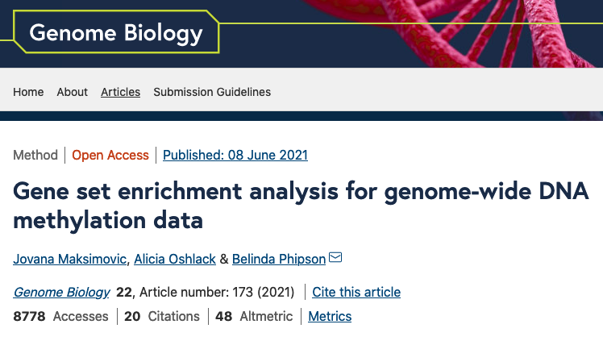
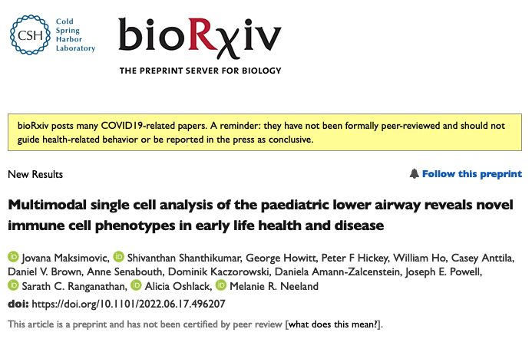
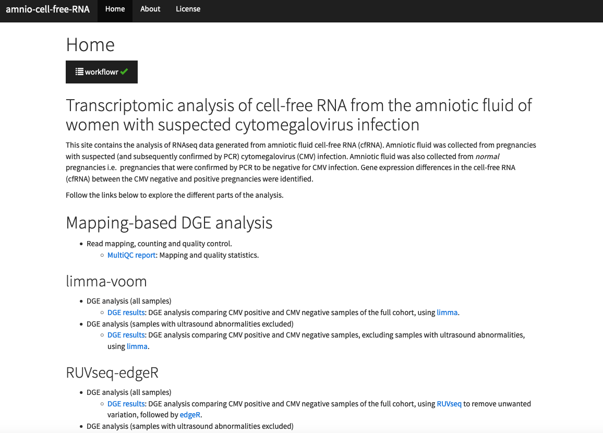
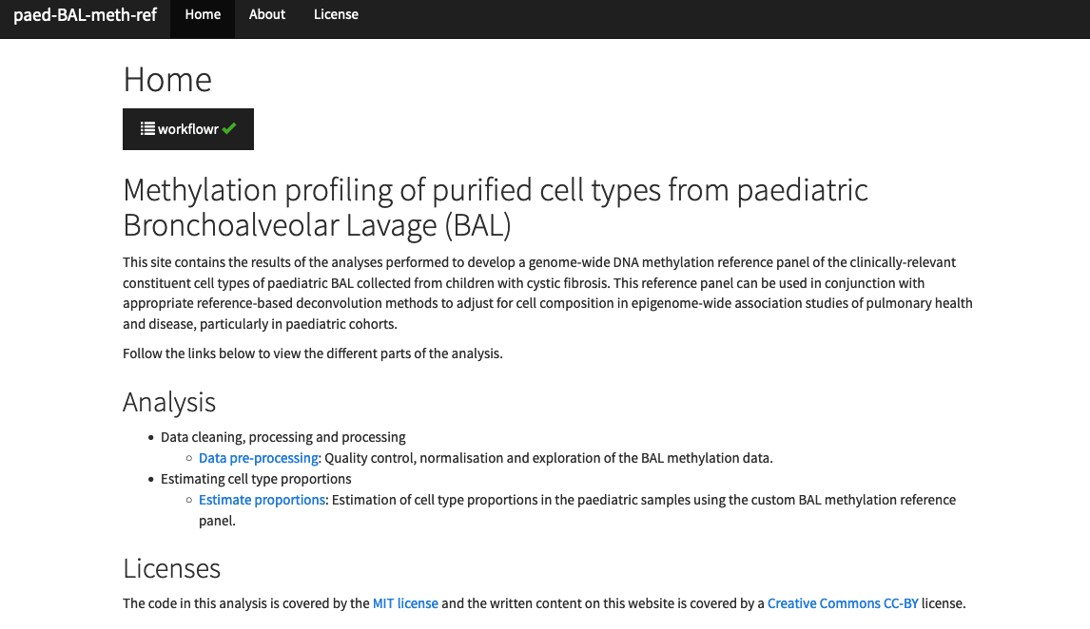
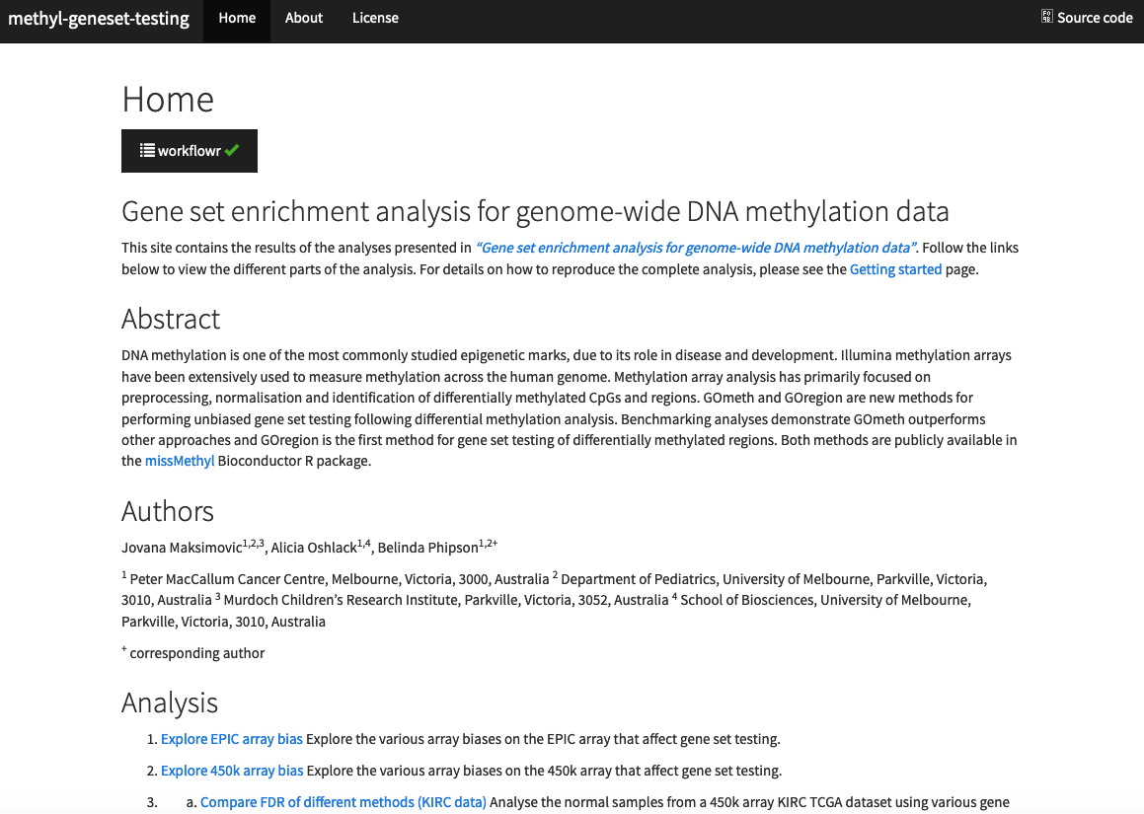

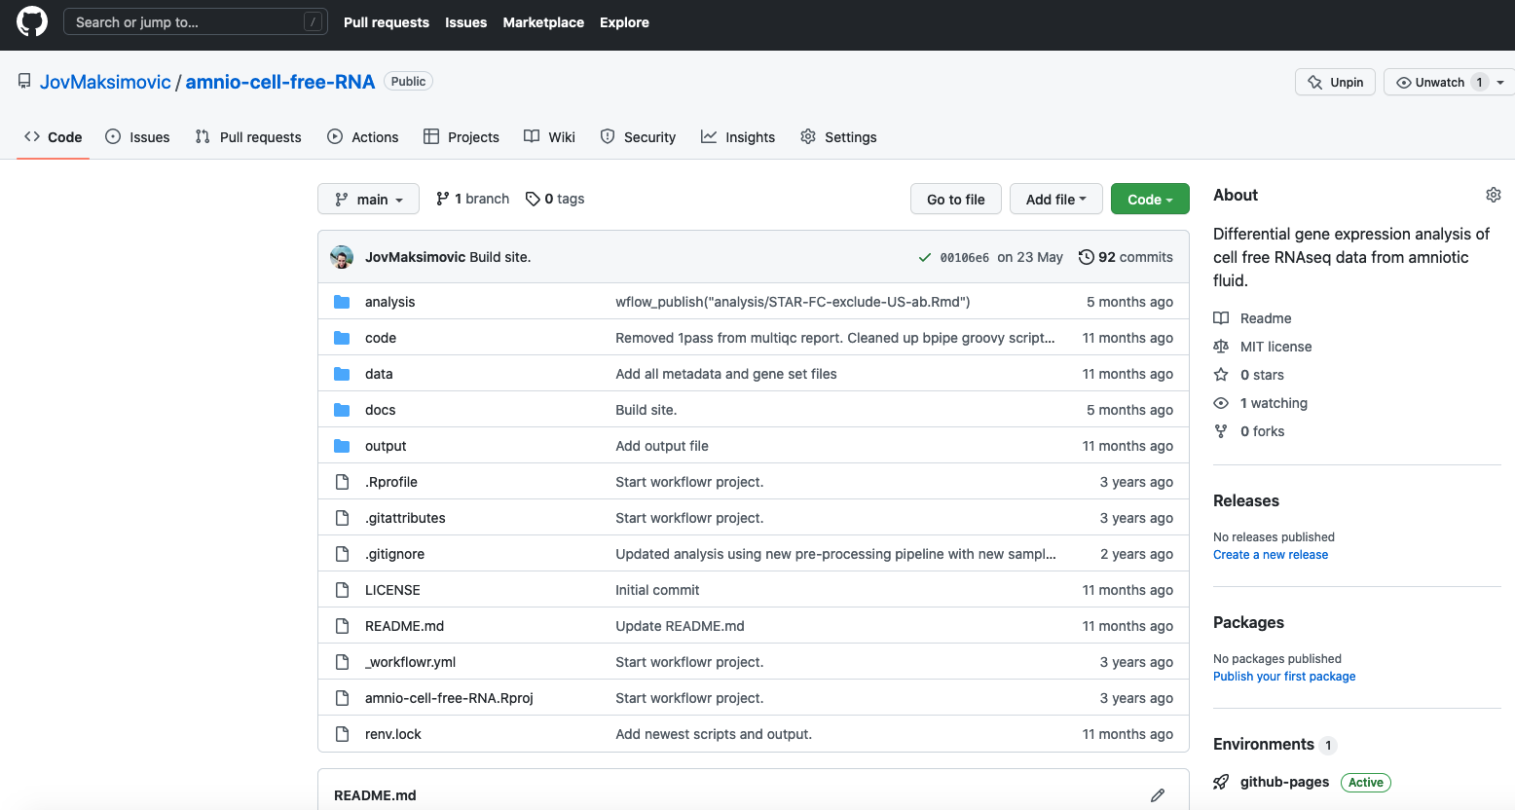
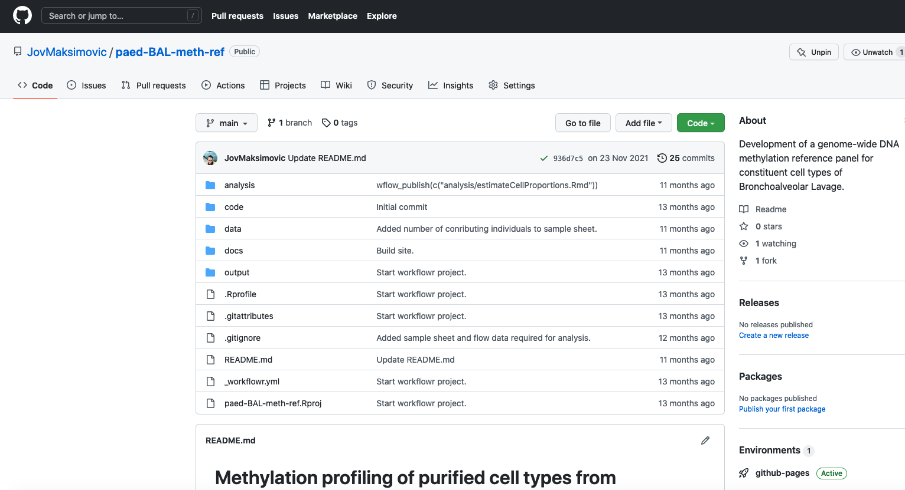
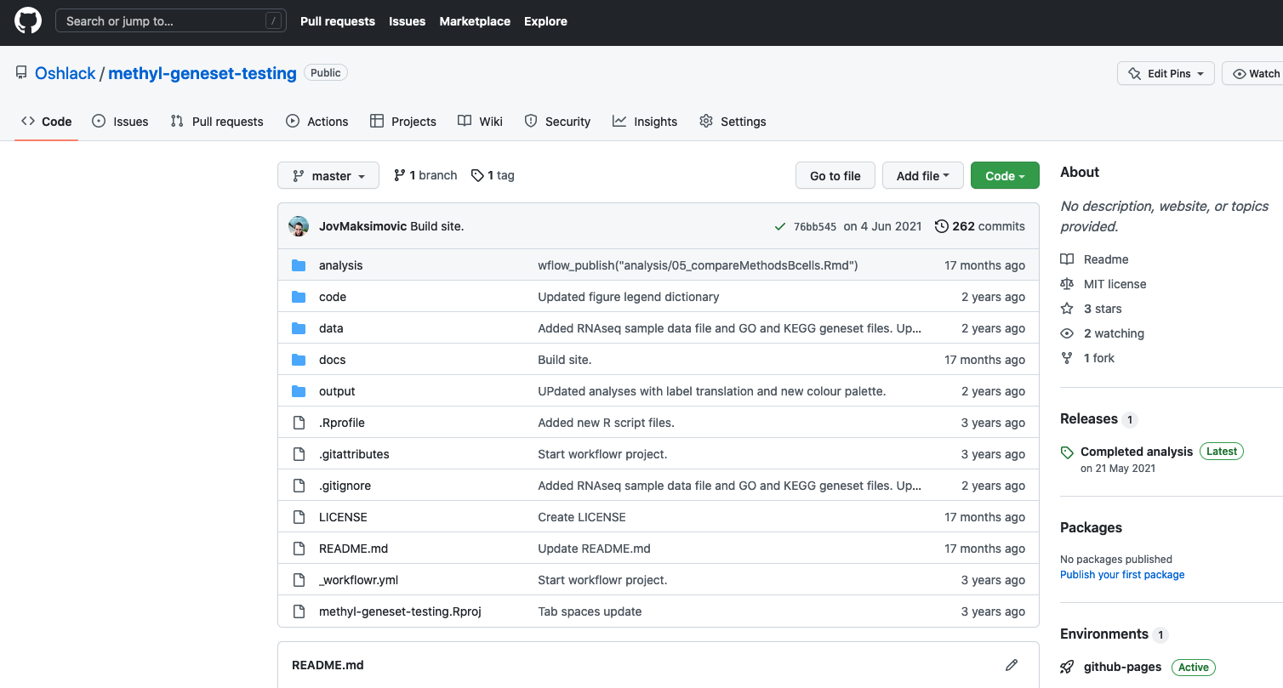
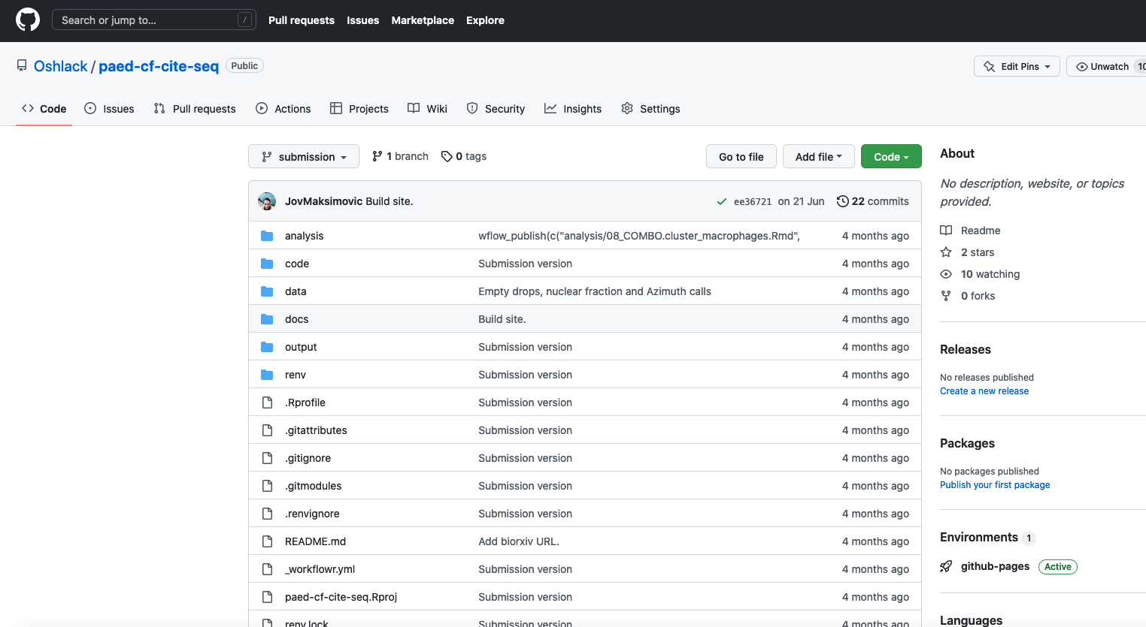

Slide 11
What is workflowr and why do I love it?

Slide 12

What is workflowr?
R package on CRAN
https://cran.r-project.org/web/packages/workflowr/index.html
Helps researchers organize analyses to promote:
Effective project management
Reproducibility
Collaboration
Sharing of results
Combines literate programming (knitr and rmarkdown) and version control (Git via git2r)
Generates a website containing time-stamped, versioned, and documented results

Slide 13

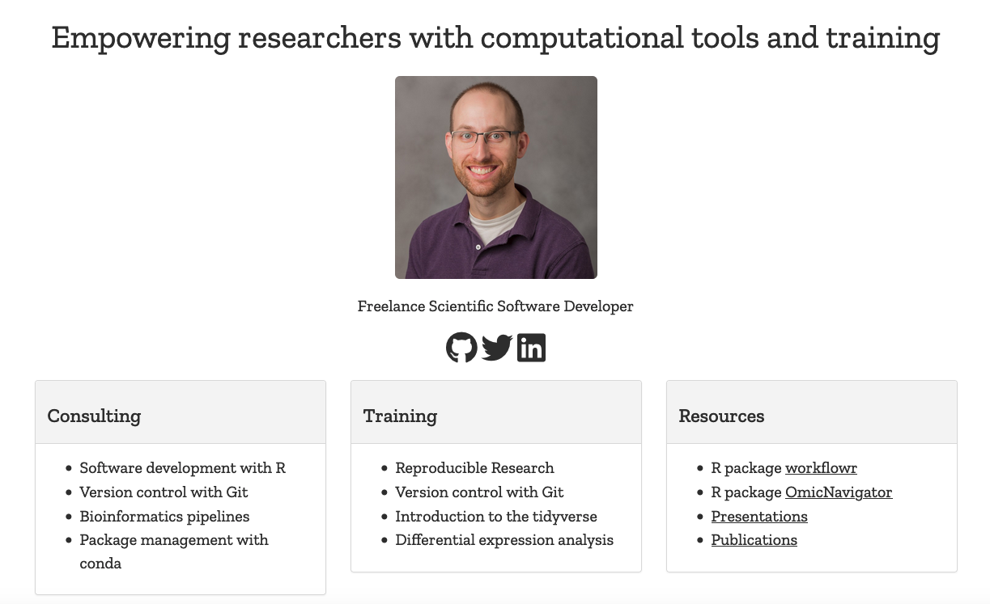
workflowr
Created by John Blischak: https://jdblischak.com/
Alpha released in 2017; paper published 2019
@jdblischak
Paper: https://f1000research.com/articles/8-1749
GitHub: https://github.com/workflowr/workflowr
Docs: https://workflowr.github.io/workflowr/
Registered projects: https://workflowr.io/

Slide 14
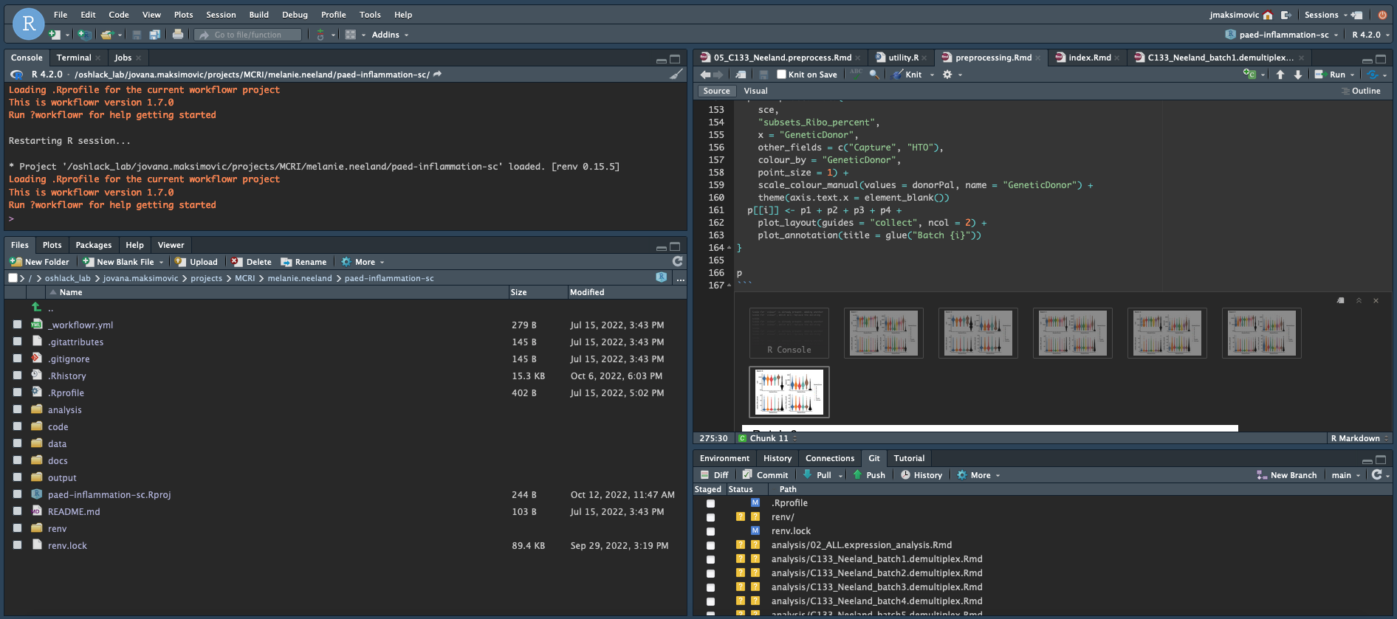
Why I love workflowr (1)
Organized
Provides a project template with organized subdirectories
Mixes code and results with R Markdown
Uses Git to version both source code and results

Slide 15
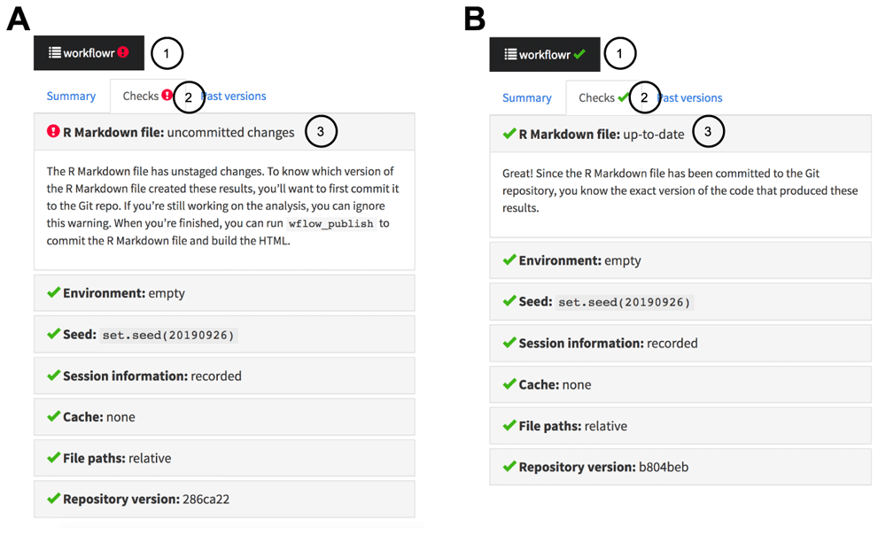
Why I love workflowr (2)
Reproducible
Displays the code version used to create each result
Runs each analysis in an isolated R session
Records the session information of each analysis
Sets the same seed for random number generation for each analysis
Blischak, John D., Peter Carbonetto, and Matthew Stephens. 2019. “Creating and Sharing Reproducible Research Code the Workflowr Way.” F1000Research 8 (October): 1749. doi:10.12688/f1000research.20843.1.

Slide 16
Why I love workflowr (3)
Shareable
Creates a website to present your research results
Creates links to past versions of results
Host your website for free via GitHub Pages or GitLab Pages or Bitbucket
Analysis websites are great for sharing in Tweetorials! https://twitter.com/melanie_neeland/status/1538691318435938305

Slide 17
Example workflowr workflow & live demo

Slide 18
The workflowr workflow
wflow_start()
Creates a default file structure for project – an existing directory can be used. Creates a Git repository, commits the files and directories – all done behind the scenes.
wflow_build()
Runs code and renders the results as HTML files in the docs/ directory. Background actions to ensure reproducibility: clean R session, working directory set consistently, sets seed, records session and computing environment information.
wflow_publish()
Performs a three-step process to store the code and results in a project development history: (1) Commits changes to the Rmd analysis file. (2) Builds the results HTML file from the Rmd file; HTML file is tagged with unique version of the Git repository. (3) The results HTML file, as well as any related figure files, are committed to the Git repository.
wflow_status()
Gets overview of project status.
wflow_git_push()
Push to remote Git repository e.g. GitHub, GitLab, Bitbucket.

Slide 19
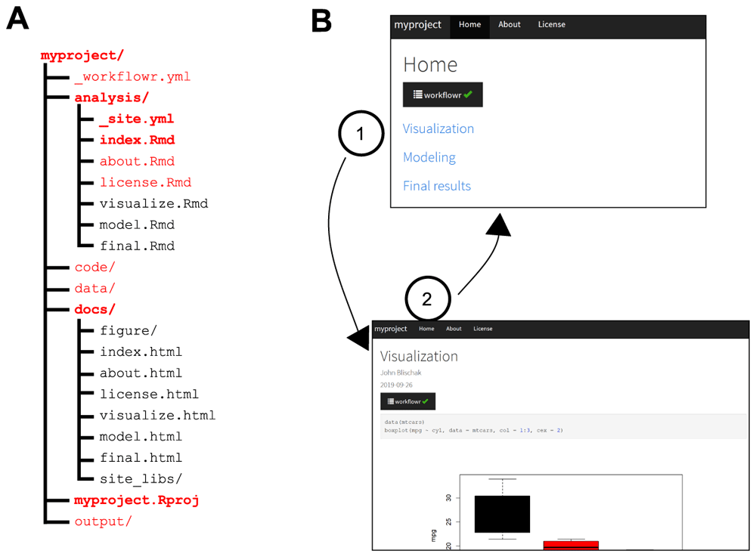
Start the project
# Install the latest version of the package install.packages(“workflowr”)
# Load the library library("workflowr")
# Configure Git (only need to do once per computer) wflow_git_config(user.name = "Full Name", user.email = "email@domain")
# Start a new workflowr project wflow_start("~/myproject") or wflow_start("~/myproject”, existing=TRUE)
# If using RStudio, open the myproject.Rproj
Blischak, John D., Peter Carbonetto, and Matthew Stephens. 2019. “Creating and Sharing Reproducible Research Code the Workflowr Way.” F1000Research 8 (October): 1749. doi:10.12688/f1000research.20843.1.

Slide 20
Build the website
# Build the site wflow_build()
# Customize your site! 1. Add new or copy existing R Markdown files to analysis/ (create demo.Rmd)
2. Edit the theme and layout in analysis/_site.yml
3. Edit index.Rmd to add links to analysis pages (demo.html)
Blischak, John D., Peter Carbonetto, and Matthew Stephens. 2019. “Creating and Sharing Reproducible Research Code the Workflowr Way.” F1000Research 8 (October): 1749. doi:10.12688/f1000research.20843.1.

Slide 21
Add some analysis
options(scipen=999) # turn-off scientific notation like 1e+48 library(ggplot2) data("midwest", package = "ggplot2")
gg <- ggplot(midwest, aes(x=area, y=poptotal)) + geom_point(aes(col=state, size=popdensity)) + geom_smooth(method="loess", se=F) + xlim(c(0, 0.1)) + ylim(c(0, 500000)) + labs(subtitle="Area Vs Population", y="Population", x="Area", title="Scatterplot", caption = "Source: midwest") gg
# publish the website wflow_publish(“analysis/demo.Rmd”, “Added new analysis”)

Slide 22
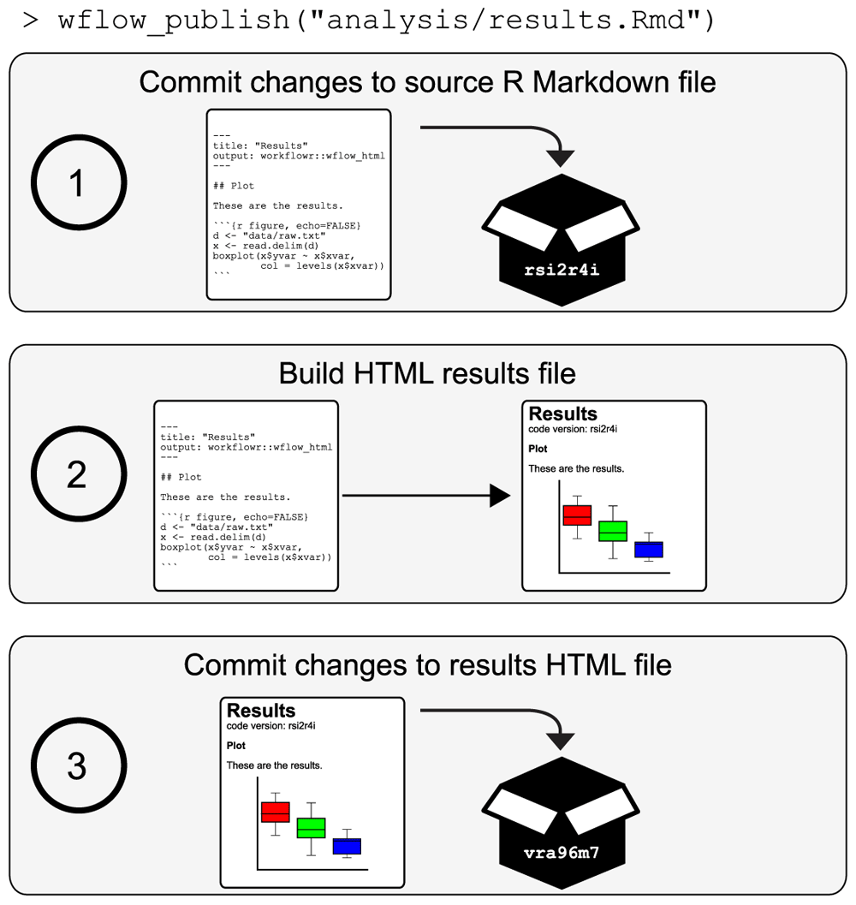
Publish the website
# Preview your changes wflow_build()
# Publish the site, i.e. version the source code and HTML results wflow_publish("analysis/*", "Start my new project")
Blischak, John D., Peter Carbonetto, and Matthew Stephens. 2019. “Creating and Sharing Reproducible Research Code the Workflowr Way.” F1000Research 8 (October): 1749. doi:10.12688/f1000research.20843.1.

Slide 23
Deploy to GitHub
# Deploy to GitHub wflow_use_github("JovMaksimovic")
# Two options available:
1. Have workflowr attempt to automatically create the repository "myproject" on GitHub. This requires logging into GitHub and enabling the workflowr-oauth-app access to the account "JovMaksimovic".
2. Create the repository "myproject" yourself by going to https://github.com/new and entering "myproject" for the Repository name. This is the default option.
# If automatically created, copy code to push an existing repository from the command line into terminal git remote add origin git@github.com:JovMaksimovic/myproject.git git branch -M main
git push -u origin main

Slide 24
Enable GitHub pages and share!
Refresh newly created GitHub repo
Go to Settings => Pages
Under Branch heading, from drop down select:
main branch
docs/ folder
Click Save
Periodically refresh page until the site goes live
Click on Visit Site
Explore and share your brand new analysis website!
IRL example: https://oshlacklab.com/paed-cf-cite-seq/

Slide 25
Extra tips for enhancing reproducibility

Slide 26
The here package: a better path
Use the here R package to ensure that your paths are always correct relative to the location of your Rproj file
Using here() to create file paths ensures that the same code will run both interactively and when building/publishing or knitting your R markdown
install.packages("here")
library("here")
here()
here("data")

Slide 27
Level up your reproducibility with renv
The renv package is an effort to bring project-local R dependency management to your projects
renv helps manage library paths (and other project-specific state) to help isolate your project’s R dependencies
Existing tools you’ve used for managing R packages e.g. install.packages(), remove.packages(), should work as before
Easy to incorporate renv into your existing workflowr project

Slide 28
The renv workflow
The general workflow when working with renv is:
Call renv::init() to initialize a new project-local environment with a private R library
Work in the project as normal, installing and removing new R packages as they are needed in the project
Call renv::snapshot() to save the state of the project library to the lockfile (called renv.lock)
Continue working on your project, installing and updating R packages as needed
Call renv::snapshot() again to save the state of your project, or renv::restore() to revert to the previous state as encoded in the lockfile in case of problems
Track lockfile with Git and sync with GitHub. Others can then use renv::restore(lockfile = “renv.lock”) to install exact package versions needed to reproduce your analysis

Slide 29
Summary
workflowr is an R package that helps you to easily create, organize and share your research whilst maintaining reproducibility
It is easy to use and incorporate into your data analysis
Results easily explored and shared as an analysis website
Some extra tools that I use:
The here package ensures that your code can be executed both interactively and when knitting the R markdown by creating the correct absolute paths
The renv package helps track installed package dependencies and versions to facilitate package management and reproducibility

Slide 30
Resources
workflowr CRAN: https://cloud.r-project.org/web/packages/workflowr/index.html
Paper: https://f1000research.com/articles/8-1749
GitHub: https://github.com/workflowr/workflowr
Docs: https://workflowr.github.io/workflowr/
Registered projects: https://workflowr.io/
here
CRAN: https://cran.r-project.org/web/packages/here/index.html
renv
CRAN: https://cran.r-project.org/web/packages/renv/index.html
Docs: https://rstudio.github.io/renv/articles/renv.html
https://github.com/JovMaksimovic @JovMaksimovic
My workflowr project repositories:
https://github.com/Oshlack/paed-cf-cite-seq
https://github.com/Oshlack/methyl-geneset-testing
https://github.com/JovMaksimovic/amnio-cell-free-RNA
https://github.com/JovMaksimovic/paed-BAL-meth-ref

